Slide 1
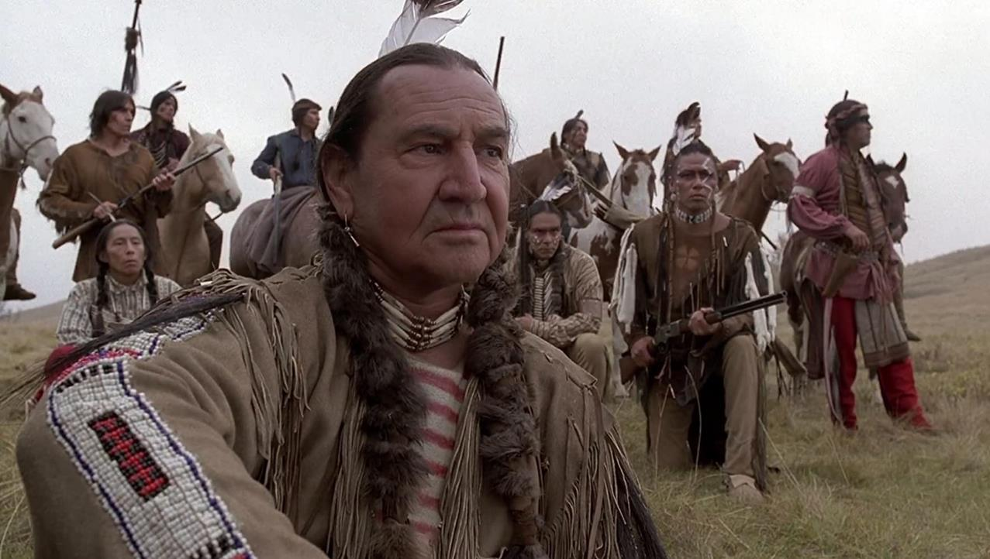
NATIVE AMERICANS AND AMERICAN FILM

Slide 2
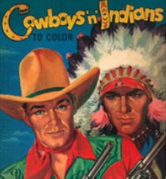
How Hollywood stereotyped the Native Americans

Slide 3
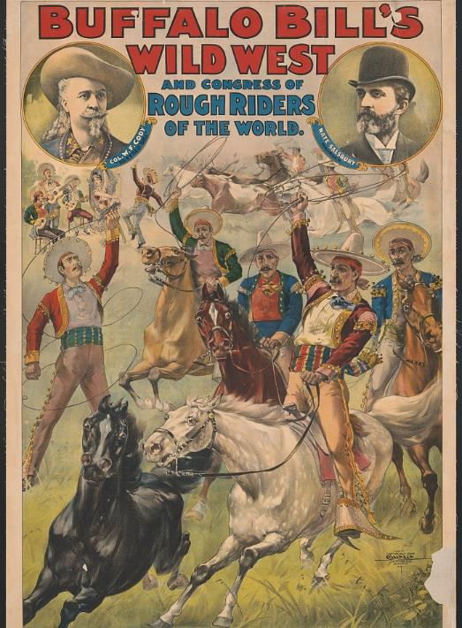

Early Silent Films
1870s-1910s: Wild West shows such as Buffalo Bill's Wild West Show popularized conflict between cowboys and Indians, presenting romanticized fiction about the American frontier which some audiences misunderstood as history. This led to widespread misrepresentation of Native Americans, despite involvement with Native American actors.
Misrepresentations included:
the ways Native Americans acted and dressed; they can be seen wearing little to no clothing with lots of feathers and beads in their hair as well as the little clothing on their bodies. The clothes that they did have on appeared to be dirty and or torn
the portrayal of Native Americans as inhumane “savages” that terrorized colonists for little to no reason
displaying Native Americans carrying torches and bows and arrows as they searched/burned the settlers’ belongings
This communicated the idea that the Native Americans were violent, had no compassion and were also responsible for the fact that Americans and indigenous people were constantly at war. As the movie industry coalesced, Native Americans were presented as more of a documentary subject. Thomas Edison’s Kinetoscope captured Lakota Indians in 1894 reenacting a ghost dance at a “Wild West” show.

Slide 4
Early Silent Films contin…
1908: D.W. Griffith released The Red Man and the Child. The film featured a sympathetic depiction of Native American characters; however, critics describe their portrayal as a "helpless Indian race...forced to recede before the advancing white." Similar depictions included The Indian Runner's Romance (1909) and The Red Man's View (1909).
Circa 1910: Nanticoke film director James Young Deer was hired by Pathé to produce accurate Native American silent films with positive portrayals. Deer, an actor, writer, and director, was involved in the production of over 150 movies, an example being White Fawn's Devotion (1910).
1912: Griffith released A Pueblo Legend and The Massacre, which both failed to show Native Americans in a positive light. The Massacre romanticized Custer's roles in the Indian Wars, with recurring scenes of white mother struggling to protect her infant, while a Native American mother is killed and collapses offscreen.
1914: Griffith featured the “hostile savage” stereotype in his film The Battle at Elderbush Gulch. Red Indians—as they were referred to in the film—surround a family and threaten their lives until the white cavalry comes to their aid.
Theodore Wharton directed the propaganda film The Indian War Refought: The Wars for Civilization in America which romanticized multiple battles including the 1890 Wounded Knee Massacre. It was directed by the War Department and approved by the United States government with the goal of rationalizing the government's actions.
Ethnologist Edward S. Curtis directed In The Land of the Head Hunters, a fictionalized documentary about the lives and culture of Kwakwakaʼwakw people of the Queen Charlotte Strait in Canada. Although Curtis wrote and directed the film, all of its actors were entirely Kwakwakaʼwakw.

Slide 5
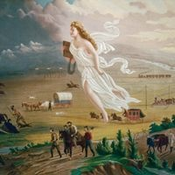
Westerns
In the postwar period, the heyday of the western, Native Americans were relegated to reservations, still struggling for rights such as having any political influence, owning a business outside the reservation and buying property. With passage of the Indian Civil Rights Act in 1968, Native Americans pressed for more realistic and historical media representation without fear of reprisal.
By 1910, one-fifth of American films were Westerns.
Manifest Destiny: the idea that white settler Americans were divinely ordained to move west and take over the entire continent of North America.
The Western’s iconography (its sights and sounds) include cowboys, Indians, six‐shooters, tumbleweeds, horses, saloons, cattle drives, etc. The issues and ideas, themes, and meanings upon which it focuses on bringing civilization to the Western wilderness. Often, this is embodied by a strong individual (almost always a straight white male) standing “tall in the saddle” and using righteous violence (his gun) to protect the expanding American community from those who would harm it.
In the Western genre, Native Americans are posited as part of “the wilderness” that must be tamed and thus, many (but not all) Western artifacts represent indigenous people as a threat to the expansion of American civilization. More than most genres, the Western is closely tied to actual issues and events in American history, and has been influential in helping to create a sense of national identity. It is often said that the Western is the “most American” of genres.

Slide 6
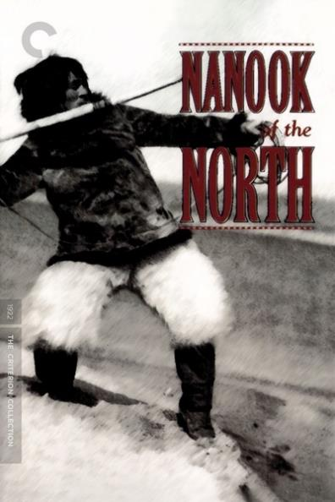
Ethnographic Films
Problems of authenticity and documentary veracity surrounded ethnographic films for many years. One of the most famous ethnographic films ever made, Nanook of the North (1922), involved the staging of Native American life by a white filmmaker.
Director Robert Flaherty did film actual Inuit people – but he requested that they revert to “traditional” Inuit living so he could film them as romanticized primitives, noble savages for 1920s audiences. Flaherty also staged certain scenes, such as the seal hunt, a sequence that was praised for its realism by many critics. He inserted subtitles that claim that they are fascinated with how a gramophone works, suggesting that they have never seen such a device before. He also cut back and forth between Inuit people eating and a dog pack snarling hungrily, thus making a formal association between the dogs and the “animalistic” tendencies of these people.
Under the claim of scientific veracity, such ethnographic accounts of Native Americans often served up the same stereotypical representations as did fictional films.

Slide 7
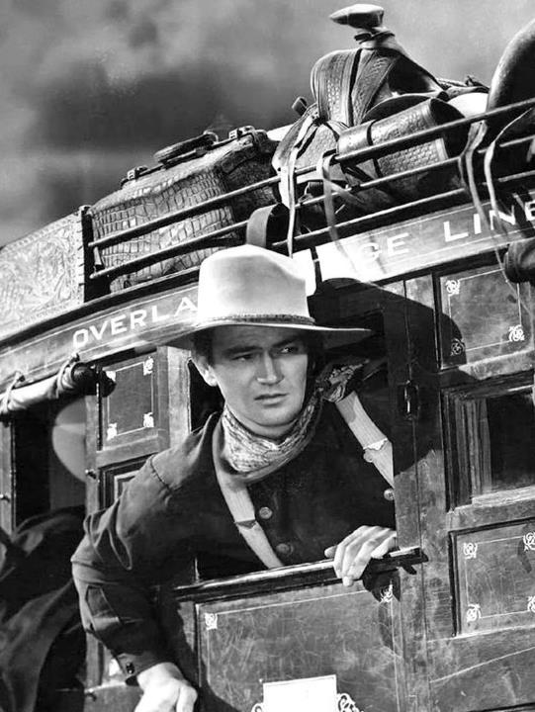
A Revitalized Western Genre
By the 1930s, most Westerns were considered unimportant, low‐budget films. However, the genre was revitalized in 1939 when John Ford directed John Wayne in Stagecoach (1939).
Stagecoach, perhaps more than any other film, cemented in the public’s mind what the classical Hollywood Western was all about – thrilling action sequences among the breathtaking scenery of the Old West in which a white male hero defeated Indians and other bad guys. A balm for the historical crimes of the nation against indigenous peoples, the classical Hollywood Western was ultimately one of the most racist of American film genres.
It was not until the civil rights movement of the postwar era that some American filmmakers began to challenge the assumptions and implications of the form.

Slide 8
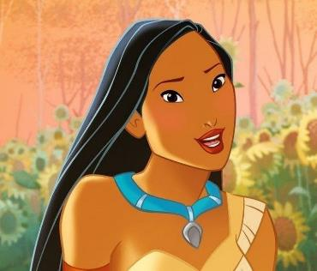
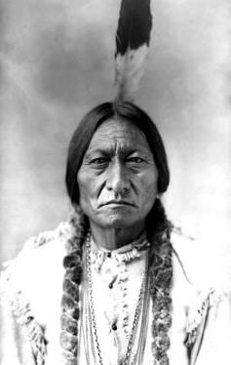
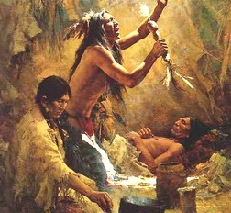
Common Indigenous Stereotypes in Film
Beautiful Maidens Indigenous women as portrayed as promiscuous beings or objects of sexual desire for White men. The impact of this stereotype is that Indigenous women suffer from high rates of sexual assaults, often perpetrated by non-Indigenous men. Indigenous girls are also often subjected to derogatory sexual comments.
Stoic Indians This representation of Indigenous tribal members paints them as one-dimensional people who never smile, speak few words and lack the ability to experience or display a similar range of emotions as other racial groups.
Magical Medicine Men Indigenous males are often portrayed in film as wise men with magical powers. Usually performing as medicine men of some kind, these characters have little function other than to guide White characters in the right direction.

Slide 9
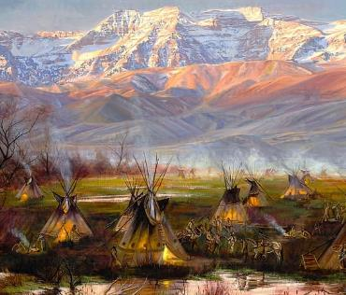
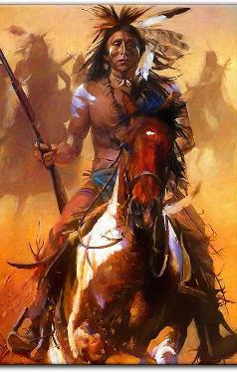
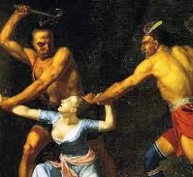
Common Indigenous Stereotypes in Film
Bloodthirsty Savages Hollywood has traditionally portrayed Indigenous peoples as tomahawk-wielding savages, ready to attack White characters and their families, including scalping people they have killed and sexually violating White women.
Noble Warriors Showed Native Americans as primitive and childlike rather than threatening and violent. According to this stereotype, Native Americans, lacking in European customs, supposedly maintained purer instincts about nature and the world around them. These links to the natural world gave Native Americans a certain majesty or nobility in the Eurocentric imagination, and that “nobility” was further enhanced when Native Americans aided and abetted white settlers. While the image of the noble savage may seem the opposite of the bloodthirsty savage, both still conceive of Native Americans as barely one step above animals, guided by instinct rather than complex thought, and without their own cultures or civilizations.
In the Wild and on the Rez Indigenous peoples are typically portrayed as living in the wilderness and on reservations. In reality, considerable numbers of tribal members peoples live off reservations, including major cities and just about everywhere else across the U.S. and around the globe.

Slide 10
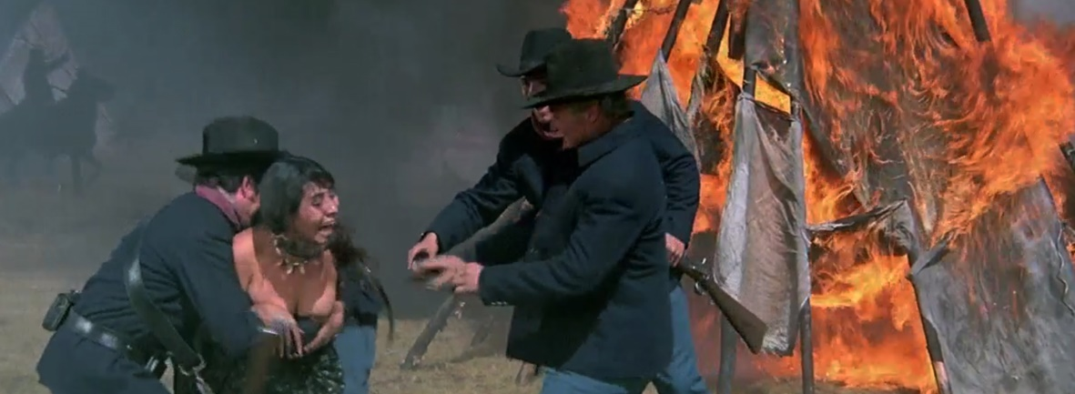
Realism and Empathy
In 1970, a more realistic and empathetic view of Indigenous Americans began to be portrayed on the big screen, in part because they were involved in the filmmaking process. That year, Soldier Blue (1970), billed by the studio as “the Most Savage Film in History!,” put forth an allegory of the Vietnam War, as a soldier enlisted to slaughter Native Americans realizes the true horror of an invader army killing people on the very land they are from. Much like the contemporary opposition to the Vietnam War, the fictional soldier’s rebellion and protest based on his firsthand experience is complex and met with resistance.

Slide 11
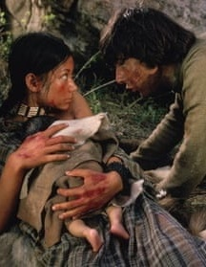
Revisionist Western
The Revisionist Western, also known as a Modern Western or an Anti-Western, is a subgenre of Western films that began circa 1960. This subgenre is characterized by a darker and more cynical tone that was generally not present in earlier Western films. In the 1970s, Revisionist Westerns often portrayed Native Americans as victims and white people as the frontier's aggressive intruders.
Little Big Man (1970) is a revisionist perspective on the Plains Indians. Jack Crabb, a white orphan raised by the Cheyenne in the late 19th century, marries a Cheyenne woman, only to witness her brutal murder by Custer’s Seventh Cavalry. When he later becomes a scout for Custer, he sees the Cheyenne and Sioux exact their revenge at the Battle of the Little Bighorn.
Reception to the film was positive, due to the likeability of actor Dustin Hoffman and the story told as the uneven memories of a 121-year-old man. Realistic battle scenes were still in short supply in mainstream cinema, so graphic scenes added to the sympathy and empathy for Native Americans. It also began to make film stars of Native actors.
While the film centers on a white protagonist, the Native Americans are depicted sympathetically while members of the United States Cavalry are depicted as villains. The Cheyenne in the film are living harmoniously and peacefully at the start of the film, and it's the encroachment of the violent white men who are the harmful, disruptive influence on their culture and landscape. The film is also noted for including a Two-Spirit character as well as showing Lt. Colonel George Armstrong Custer as a lunatic – a fool and a fop – whom the white protagonist betrays for the sake of his adopted Indian family.

Slide 12
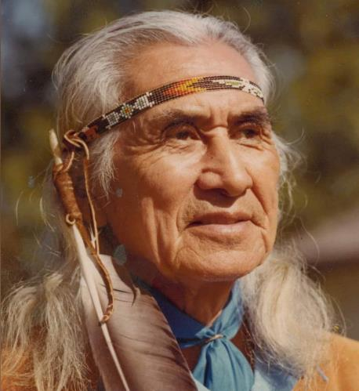
SPOTLIGHT: Chief Dan George
Chief of the Tsleil-Waututh Nation, a Coast Salish band whose Indian reserve is located on Burrard Inlet in the southeast area of the District of North Vancouver, British Columbia, Canada.
In 1970, at age 71, he received several honors for his role in Arthur Penn's film Little Big Man, including a New York Film Critics Circle Award and National Society of Film Critics Award for Best Supporting Actor, a Laurel Award for Best Supporting Performance, Male and a nomination for the Golden Globe Award and Academy Award for Best Supporting Actor.
During his acting career, he worked to promote better understanding by non-aboriginals of the First Nations people. His soliloquy, Lament for Confederation, an indictment of the appropriation of native territory by European colonialism, was performed at the City of Vancouver's celebration of the Canadian centennial in 1967. This speech is credited with escalating native political activism in Canada and touching off widespread pro-native sentiment among non-natives.

Slide 13
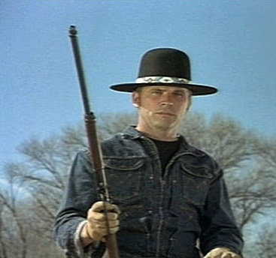
Indian‐ploitation
Popular with audiences in the 1960s-70s were the “Billy Jack” films: Born Losers (1967), Billy Jack (1971), The Trial of Billy Jack (1974), and Billy Jack Goes to Washington (1977). Somewhat analogous in narrative construction to the blaxploitation films, these films might be thought of as a sort of “Indian‐ploitation.”
In each film, Billy Jack, who is identified in the films as a “half‐breed” (half Native American and half white), encounters corruption and prejudice at the core of the American system. Although Billy Jack just wants to find peace and justice, he (like a blaxploitation hero) is usually called upon to battle his oppressors in increasingly violent ways.
Cheaply made and sensationalistic, the “Billy Jack” films may have provided a cathartic experience for some Native American moviegoers, even as they reinforced values of violent machismo.

Slide 14
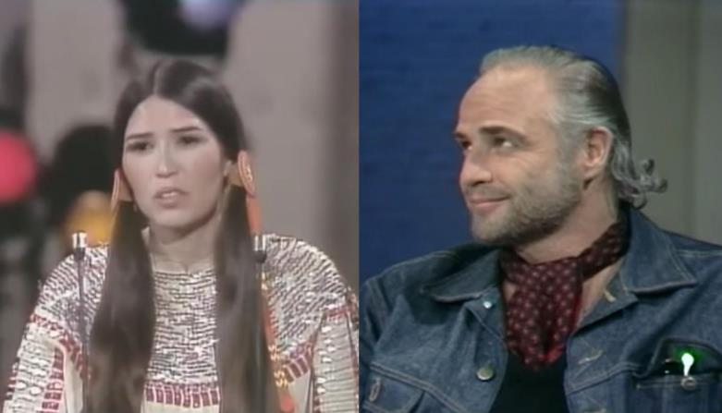
Oscar Protest
In 1973, American actor Marlon Brando declined an Academy Award in protest for the representation of Native American in Hollywood cinema, citing killing of helpless unarmed Indigenous peoples and the theft of their territory.

Slide 15
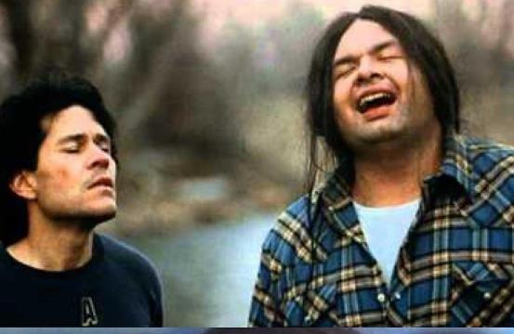
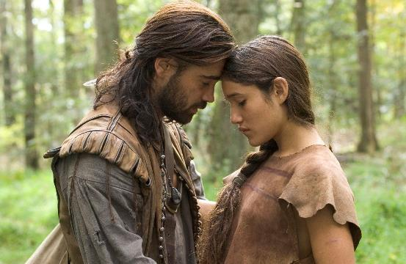
Road, Buddy and Romance Films
The 1980s saw the emergence of independent films with contemporary Native content such as:
Powwow Highway (1989): a road movie and buddy film where one protagonist, an angry young activist, namechecks the American Indian Movement while the other visits sacred sites to greet the dawn.
The New World (2005): offers a largely fictionalized retelling of the relationship between John Smith and Pocahontas. John Smith arrives to the Americas with the Pilgrims and is immediately captured by a Native American tribe. The film did offer several myths about Pocahontas, changing her into an adult so the film can be made into a love story. In reality, Pocahontas was a child of about ten when she met John Smith, and most scholars agree that some of the events in the film never took place.

Slide 16
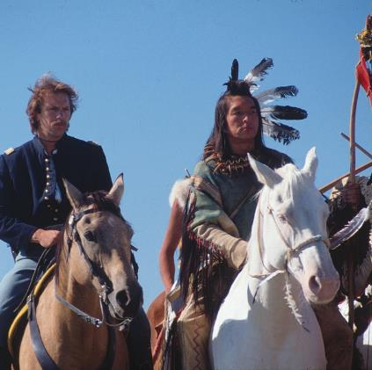
A Lens of Native American Culture
Dances With Wolves in 1990 became the standard-bearer for involving Native Americans in mainstream films that focused on their culture. This was in spite of its well-earned reputation of centering the White experience in a story featuring Native life.
The film from director-star Kevin Costner employed top Native talent and portrayed tribal life realistically. Its sweeping scope led to glory at the Academy Awards, where it won Best Picture. But the narrative focuses on a white U.S. Army officer making friends with local Sioux, only to fall in love with a white woman raised by the tribe. The couple then flee to live life in exile to “save” the Sioux, an ending that rings hollow on a deeper analysis.
Dances With Wolves was in its own way an attempt to respond to decades of Native misrepresentation on film. However, while hailed by mainstream audiences and providing jobs for many Lakota actors, it has also been cited as a return to the White savior narrative in film. In the film U.S. soldiers capture John Dunbar and take him as a prisoner. Native Americans race onto the scene and kill all of the U.S. soldiers while none of the Native Americans appear to have been killed. Some of them receive injuries, but they are portrayed as strong and immune to the pain. However, Dunbar then becomes part of the tribe and leads the Sioux against their rivals, the Pawnee, and later helps them escape the same army he once served. The final credits of the film suggest that Sioux people are now extinct, which a few criticized.
In 1992, The Last of the Mohicans, based on the James Fenimore Cooper novel, featured Native actors in leading roles, including Eric Schweig of the Inuvialuk tribe as Uncas and Oglala Lakota Russell Means as his father, Chingachgook.
For the 2015 award-winning film The Revenant, Mexican director Alejandro González Iñárritu hired cultural consultants and teamed up with linguists to incorporate authentic Arikara and Pawnee language. Secwepemc actress Grace Dove brings a strong spiritual element as the murdered wife of Leonardo DiCaprio’s Hugh Glass, a fur trapper who witnesses a traumatic attack upon his family.

Slide 17
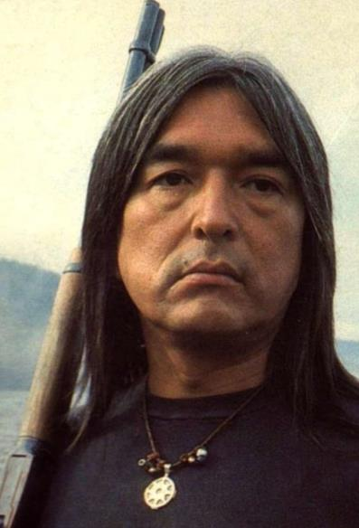
SPOTLIGHT: Graham Greene
Greene is an Oneida born in Ohsweken, on the Six Nations Reserve in Ontario.
He achieved international fame for appearing in Kevin Costner's Dances with Wolves (1990), which earned him an Academy Award nomination. In addition, he earned an Earle Grey Award and Award of Excellence at the Reelworld Film Festival for Lifetime Achievement and a RNCI Red Nation Award for Outstanding Supporting Actor in the Netflix series Longmire.
When discussing roles of native people, Greene noted that he would like to see depictions of "his people" as more than stoic: "My people are very funny."

Slide 18
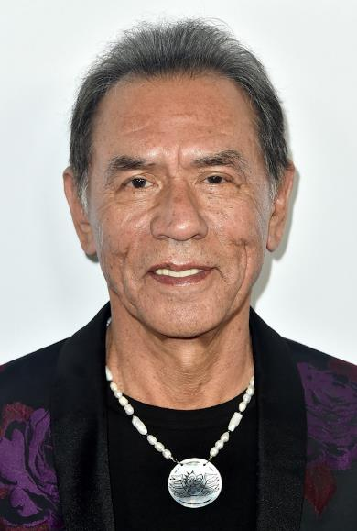
SPOTLIGHT: Wes Studi
Studi was born into a Cherokee family in Nofire Hollow, Oklahoma, a rural area in Cherokee County named after his mother's family.
In 2019, the Academy awarded him an honorary Oscar, “in recognition of the power and craft he brings to his indelible film portrayals and for his steadfast support of the Native American community,” becoming the first Native American as well as the first Indigenous person from North America to be honored by the academy.
In December 2020, The New York Times ranked him #19 in its list of the "25 Greatest Actors of the 21st Century (So Far)," noting "Wes Studi has one of the screen’s most arresting faces — jutting and creased and anchored with the kind of penetrating eyes that insist you match their gaze. Lesser directors like to use his face as a blunt symbol of the Native American experience, as a mask of nobility, of suffering, of pain that’s unknowable only because no one has asked the man wearing it. In the right movie, though, Studi doesn’t just play with a character’s facade; he peels its layers. A master of expressive opacity, he shows you the mask and what lies beneath, both the thinking and the feeling."

Slide 19
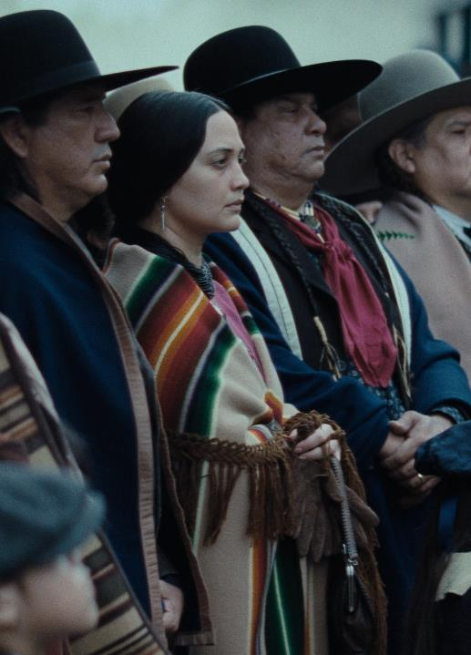
Killers of the Flower Moon
One of the most anticipated films of 2024, Killers of the Flower Moon centers around the Reign of Terror, when members of the Osage Nation were murdered by white prospectors eager to seize rights to the Osage’s oil-enriched lands.
Initially DiCaprio was to portray Tom White, the federal agent from Washington, D.C. who arrives to solve the murders, but switched to the role of Ernest Burkhart, the nephew of rancher William Hale who comes to Oklahoma for work, as the script evolved. Burkhart and his relationship with his Osage wife, played by Blackfoot actor Lily Gladstone, are now at the core of the plot. That script evolution came about after director Martin Scorsese and his team visited the Osage community in Pawhuska, Oklahoma, and realized he was making a white savior story focused on the precursor to the FBI rather than the human story of the people being murdered. The generosity and welcoming spirit of the Osage at several meetings and dinners convinced him to change the script.
The Osage museum and archives provided much of the set production for the film. Osage artist and designer Dante Biss-Grayson was brought in to help with the film’s authenticity.
Beyond the look, the production team wanted authenticity in the actors. Scorsese wanted to include Osage people to make sure characters were behaving and saying things that would be appropriate for an Osage person.
Music composer John Williams, a leader in the Osage Nation, served as a cultural consultant and became an important part of the team.
With Killers of the Flower Moon setting the bar so high, the future of mainstream Native representation in film looks to be on the rise. The movie enters a cinematic conversation with its predecessors, but in new and provocative ways.

Slide 20
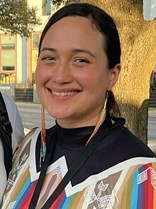
SPOTLIGHT: Lily Gladstone
Raised on the Blackfeet Reservation in Browning, Montana, Gladstone is of Piegan Blackfeet, Nez Perce, and European heritage.
Her career breakthrough was playing Jamie, a rancher, in Kelly Reichardt's film Certain Women (2016). The role earned Gladstone the Los Angeles Film Critics Association Award for Best Supporting Actress and the Boston Society of Film Critics Award for Best Supporting Actress. She also received nominations for the Independent Spirit Award for Best Supporting Female and Gotham Independent Film Award for Breakthrough Actor.
She earned critical acclaim for portraying Mollie Kyle, an Osage woman who survived the Osage Indian murders, in Martin Scorsese's crime drama film Killers of the Flower Moon (2023). She became the first Native American to win the Golden Globe Award for Best Actress in a Motion Picture–Drama, the Screen Actors Guild Award for Best Female Actor, and be nominated for the Academy Award for Best Actress.

Slide 21
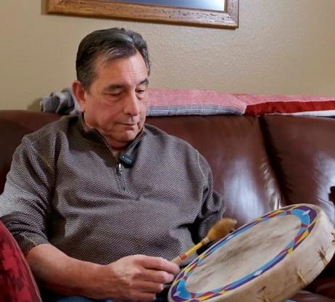
SPOTLIGHT: Scott George
Scott George was born in Kansas and raised in Hominy, Oklahoma. As of 2024, he has spent 30 years working in tribal housing, including a decade as director of the Citizen Potawatomi Nation's housing department. He began singing at age 16 and has sung in I'n-Lon-Schka drum committees since 1983. He began composing his own music in 2000, mostly in the Ponca language.
In a historic moment for Indigenous representation at the Academy Awards, George, a member of the Osage Nation, is the first Native American to receive an Oscar nomination for Best Original Song with his composition, “Wahzhazhe (A Song For My People)” for Martine Scorcese’s Killers of the Flower Moon.
This landmark nomination not only celebrates George’s talent but also serves as a powerful testament to the resilience and cultural richness of the Osage Nation and Indigenous peoples worldwide. The song is an anthem written and performed in the Osage language. It encourages tribal members to rise up, be strong, and have faith through life’s ordeals. George, a respected figure within the Osage community, collaborated with two dozen female and male singers who gathered around a drum to create the piece of music.

Slide 22
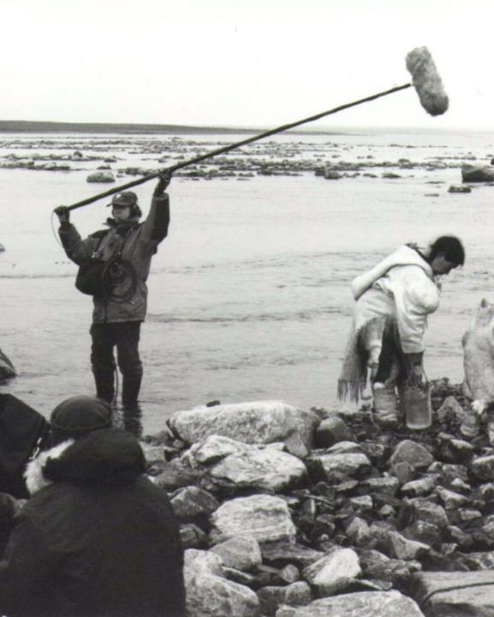
Visual Sovereignty
Visual sovereignty is a way of looking at indigenous sovereignty outside of legal parameters defined by Seneca scholar Michelle H. Raheja as "a way of reimagining Native-centered articulations of self-representation and autonomy that engage the powerful ideologies of mass media," to take back the right to tell their own stories.
Igloolik Isuma Productions was the first Inuit owned production company. Isuma was formed in 1981 and created Inuit films in their native language Inuktitut.
Native Filmmaker Chris Eyre wrote and directed the film Smoke Signals in 1998, which has been selected for preservation in the National Film Registry for being "culturally, historically, or aesthetically significant". It is one of few films featuring Native American characters and directed by a Native filmmaker that received theatrical distribution. Smoke Signals was written, directed, and acted in by Native Americans and examines friendship, fatherhood, and the roles of tradition versus modernity in Indian Country.

Slide 23
Representation Statistics
Report by Associate Professor of Communication Stacy L. Smith and the Annenberg Inclusion Initiative - examined Native representation across 1,600 top-grossing films - more than 62,000 speaking or named characters - from 2007 to 2022
Overall, less than one-quarter of one percent (<0.25%) of all speaking roles went to Native American characters. Yet, Native Americans are 1.3% of the U.S. population, according to the Census.
There was only 1 film with a Native actor in the leading role, while nearly two-thirds (65%) of all Native American speaking characters were inconsequential to the plot, and 34.6% filled secondary roles.
Filmmakers do not tell stories that put Native women at the center. Moreover, when a cast features Native men and women it is clearly a departure from the patterns of erasure and invisibility that are often the norm when it comes to this community. When Native American characters did appear on screen, they were most often male-identified—77% of Native characters were male and 23% were female. Native characters were most likely to be in young to mid-adulthood, as 36% were age 21-39 and 31% were 40-64. Only 20% of Native characters were teens (age 13-20) and few elderly (11%) or child (2%) Native characters appeared in storytelling. Most films erased Native girls and women entirely. Nearly 99%-- or 1,581 movies of the 1,600 examined—did not include even one female-identified Native character who spoke or was named.
Out of 133 speaking roles held by Native characters, 99 were played by Native actors. After accounting for actors who worked more than once across the time frame, there were only 64 Native actors who worked on the most popular movies over the past 16 years. A mere 19 of those actors were women.
The report offers a set of solutions designed to enhance Native representation both in front of and behind the camera. Drawing on the work of other organizations that support Native filmmakers and actors, to increase the prevalence of Native characters and improve the portrayal of Native roles in film, the authors reinforce the need for:
project funding
development programs
Native critics

Slide 24
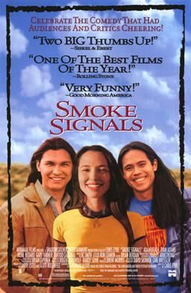
Smoke Signals (Chris Eyre, 1998, USA)
CASE STUDY
Synopsis: Arnold rescued Thomas from a fire when he was a child. Thomas thinks of Arnold as a hero, while Arnold's son Victor resents his father's alcoholism, violence and abandonment of his family.

